Slide 1



Analyzing User Engagement At Social Buzz

Slide 2


Today's agenda
Project recap
Problem
The Analytics team
Process
Insights
Summary

Slide 3

Client Background:
Social Buzz founded by former engineers from a major social media conglomerate.
Emphasizes content with anonymous user interactions, boasting 500 million monthly users.
Challenges:
Rapid growth, digital nature, and immense data generation.
200 out of 250 staff members are technical, handling complex technology.
Reasons for External Expertise:
IPO plans by the end of next year.
Limited resources for managing current scale.
Desire to learn big data best practices from large corporations.
Project Recap

Slide 4

Problem
Over 500 million monthly users in the past 5 years.
100,000+ daily content pieces .
200 technical staff managing highly complex technology.
How can we leverage big data best practices to address the challenges posed by Social Buzz's rapid growth and enormous data generation, ensuring a smooth transition to an IPO while maintaining data integrity and system scalability?

Slide 5


Andrew Fleming
Chief Technical Artchitet
The Analytics team
Marcus Rompton
Senior Principle
Eunice Okiya
Data Analyst

Slide 6
Process
1 Data Comprehension
2 Data Cleaning
3 Data Modelling
4 Analysis
5 Insights revelation

Slide 7

Insights
Sentiment Analysis:
Our sentiment analysis reveals an overwhelmingly positive user sentiment across all categories. Notably, the 'Animals' category takes the lead in positive sentiments, while 'Veganism' trails behind. Interestingly, 'Animals' also leads in both negative and neutral reviews, indicating a broad spectrum of user engagement.
Monthly Posting Trends:
Analyzing posting trends, January 2021 emerges as the month with the highest number of posts. In contrast, both June 2020 and June 2021 recorded the least activity. These variations suggest potential seasonal or topical influences on user engagement.
Reactions by Category:
Examining user reactions, the 'Animals' category stands out, receiving the highest number of reactions. Surprisingly, 'Public Speaking' records the lowest reaction count. It's noteworthy that the top 5 categories closely follow each other in terms of overall reaction count, indicating consistent user engagement.
Top 5 Categories by Scores:
Assessing content quality, the top 5 categories by scores are 'Animals,' 'Science,' 'Healthy Eating,' 'Technology,' and 'Food.' This suggests that users find content in these categories particularly engaging and valuable. 'Animals' lead in scores, showcasing a holistic positive sentiment among users.

Slide 8
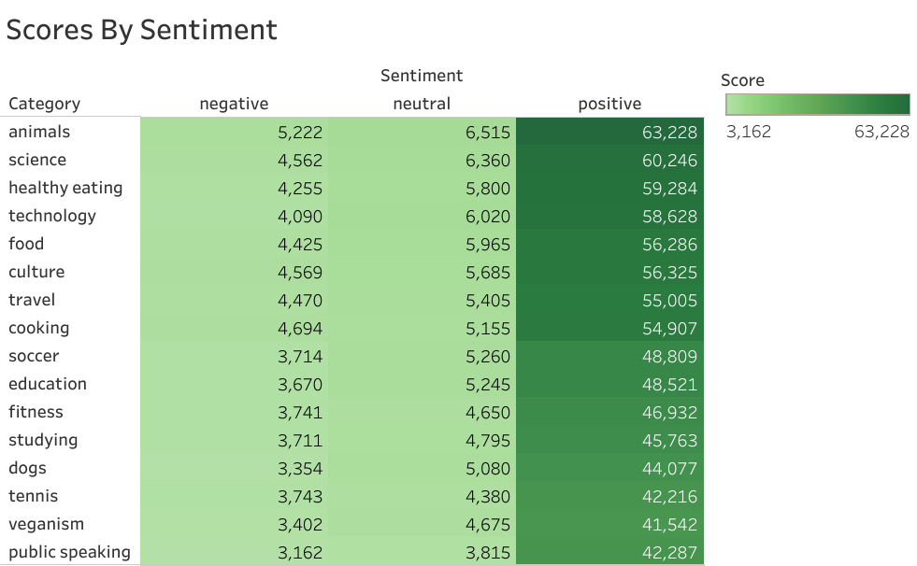
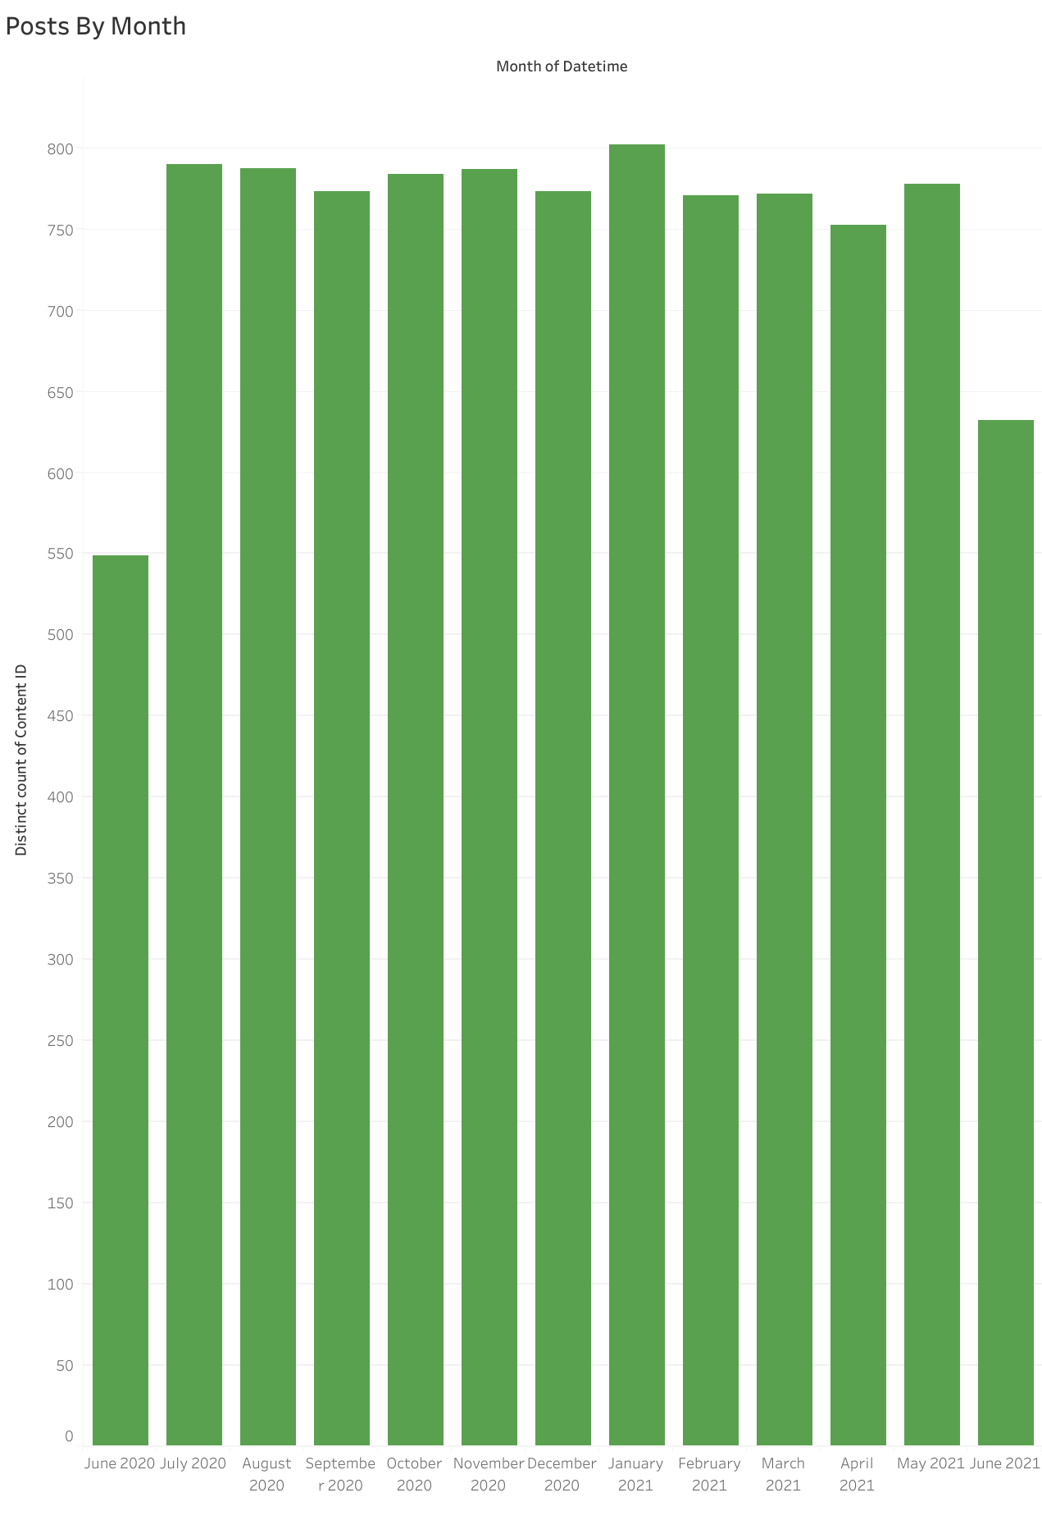

Slide 9
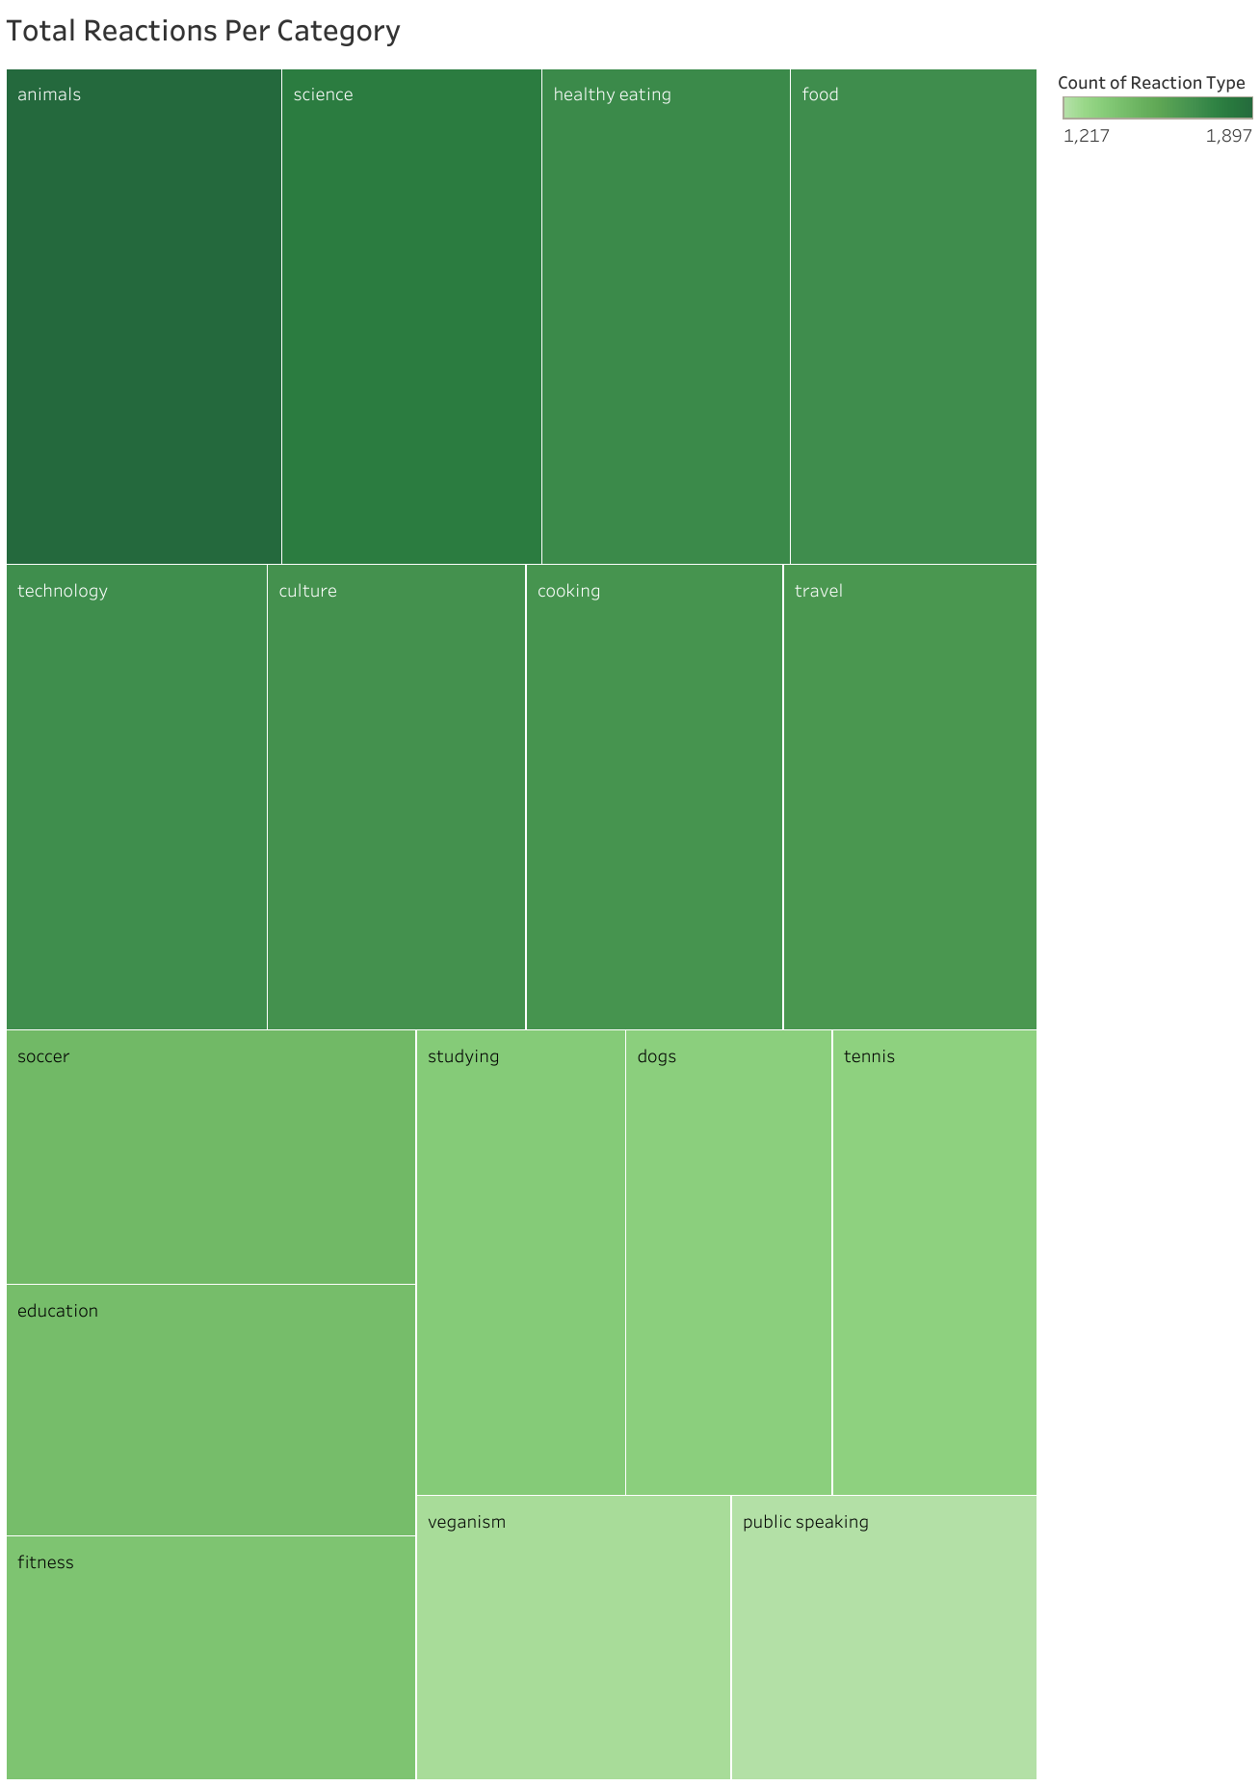
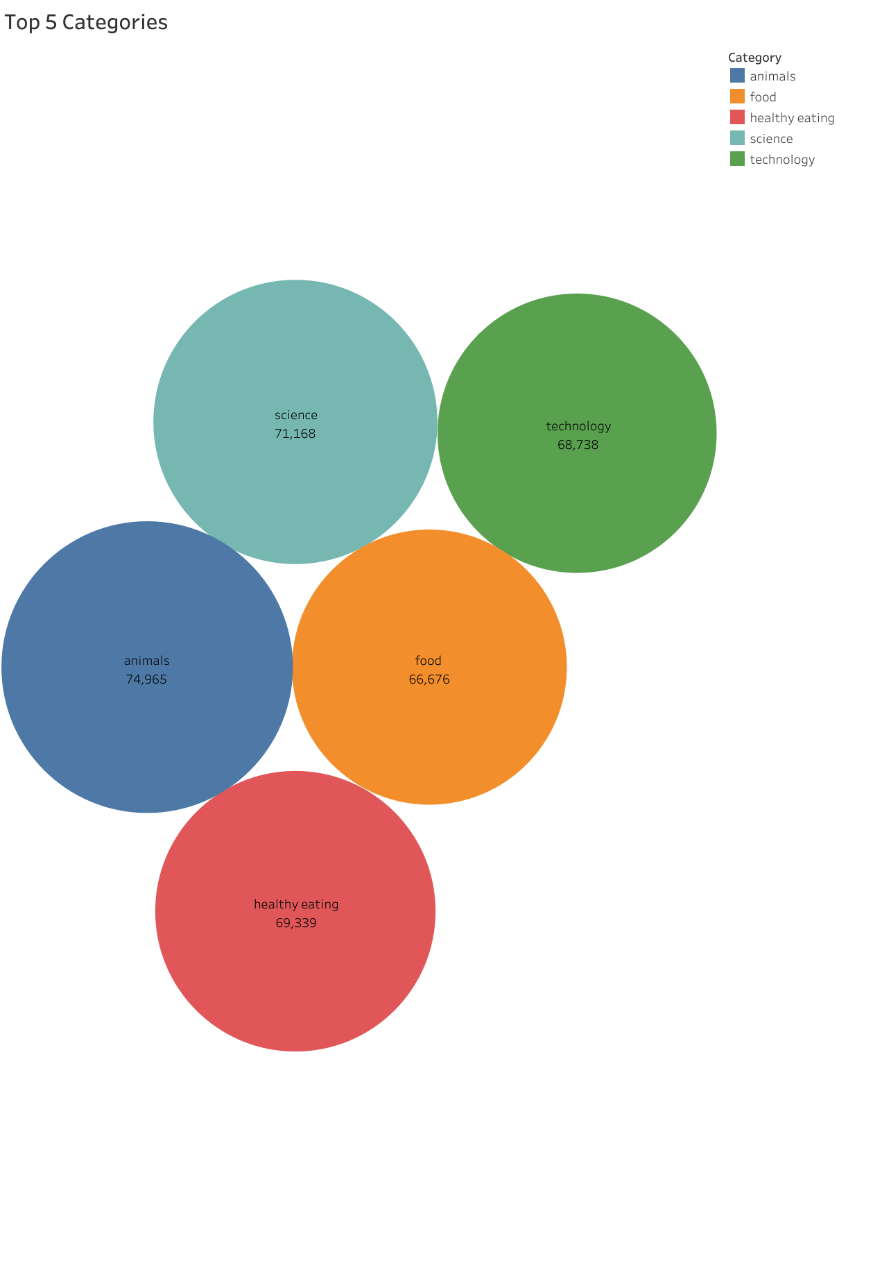

Slide 10

These insights unveil a robust positive sentiment across diverse content categories. The strong performance of 'Animals' across multiple metrics, from sentiment to reactions, suggests a high level of user affinity. Meanwhile, the monthly posting trends hint at dynamic user behavior influenced by external factors.
Leveraging the popularity of 'Animals' and optimizing content in the trailing categories could further enhance user satisfaction.
Summary

Slide 11
Thank you!
ANY QUESTIONS?

